Slide 1
MacOS Installation

Slide 2

MacOS Package manager
Følg guiden her:
https://brew.sh/
(step by step på næste slides)

Slide 3
MacOS xcode
Kopier text på hjemmesiden
https://brew.sh
Tryk på clipboardet for at kopierer (den røde knap), da der er meget tekst
[Cmd] + [Space]-> Terminal
Terminal: xcode-select --install

Slide 4
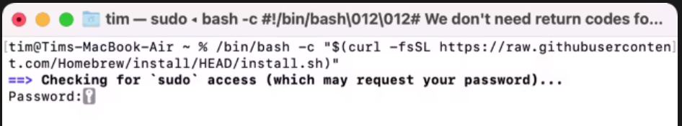
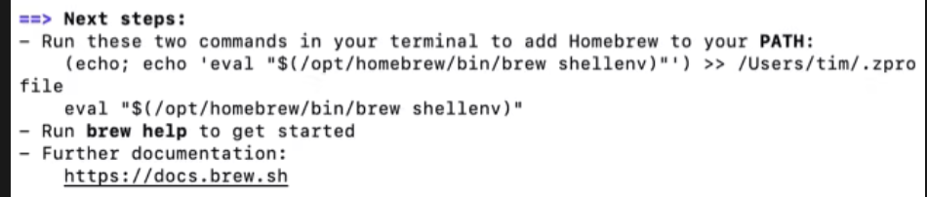
MacOS homebrew
Kopier text på hjemmesiden
https://brew.sh
Tryk på clipboardet for at kopierer (den røde knap), da der er meget tekst
[Cmd] + [Space]-> Terminal
Terminal: Indsæt + [Enter]
Terminal: Følg informationerne på skærmen (så som at skrive kode)
Terminal: echo 'eval $(/opt/homebrew/bin/brew shellenv)' >> /Users/$USER/.zprofile
Terminal: eval $(/opt/homebrew/bin/brew shellenv)
5 og 6 kan varierer lidt, se i terminalen
Luk Terminalen

Slide 5
MacOS
Terminal: brew install gcc
Terminal: brew install gdb
Terminal: brew install --cask visual-studio-code
Terminal: brew install --cask arduino-ide
[Cmd] + [Space] -> code
[Cmd] + [Space] -> arduino

Slide 6
VS Code

Slide 7
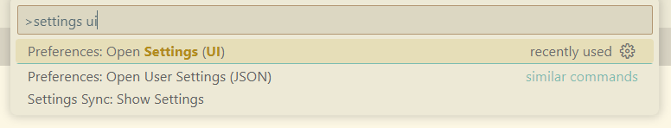
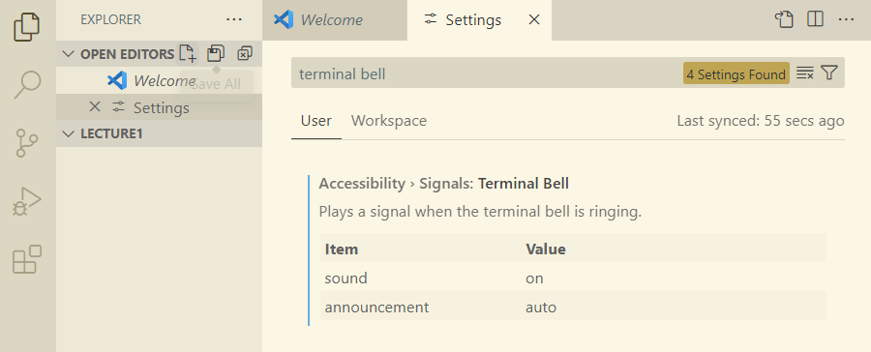
Visual Studio Code Lyd
vscode:
Windows: [CTRL] + [SHIFT] + P
MacOS: [CMD] + [SHIFT] + P
vscode: settings ui
vscode: “Terminal Bell” -> sound -> on

Slide 8
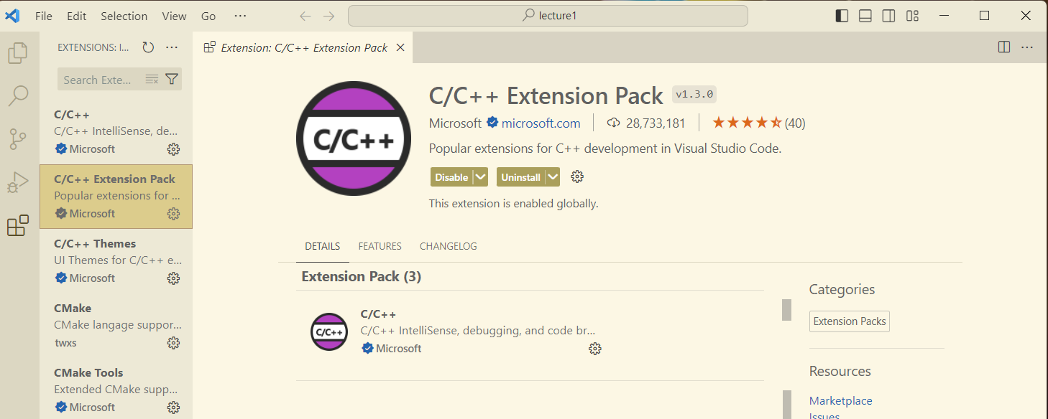
Visual Studio Code Extensions
vscode: Åben Extensions : [CTRL] + [SHIFT] + X
vscode: Søg og Installer følgende extensions:
C/C++ Extension Pack by Microsoft

Slide 9
Arduino Setup

Slide 10
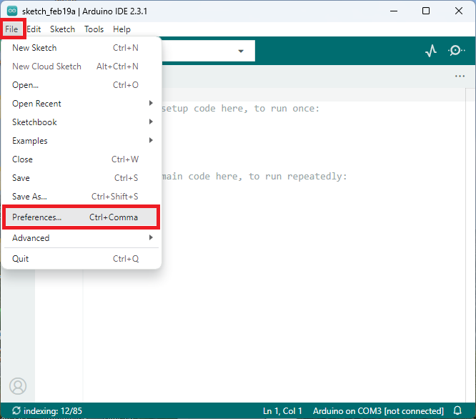
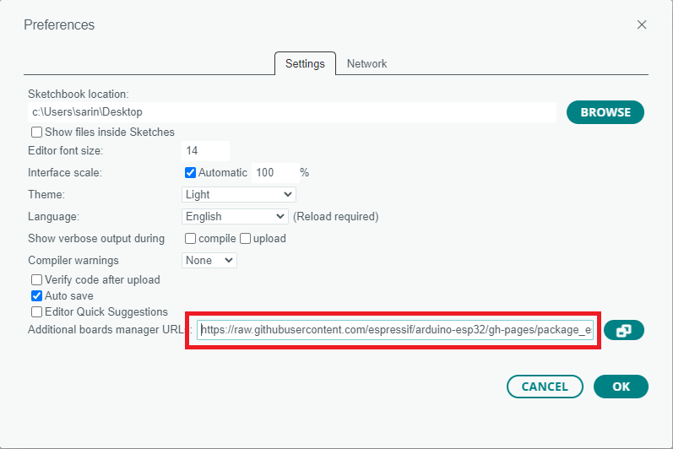
Arduino Setup
https://raw.githubusercontent.com/espressif/arduino-esp32/gh-pages/package_esp32_index.json

Slide 11
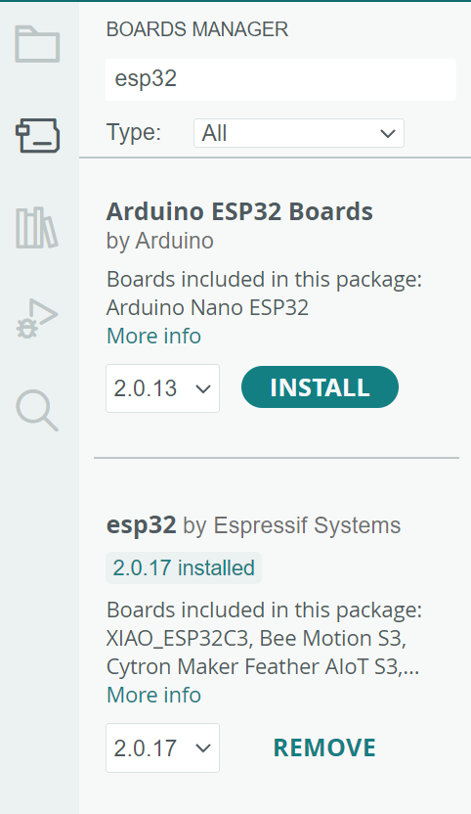
Arduino Setup

Slide 12
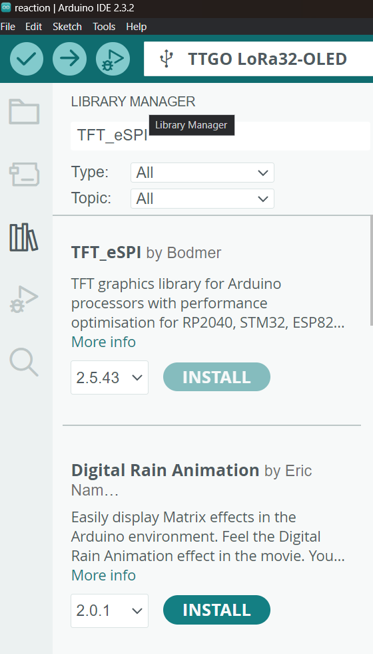
Arduino Setup Display driver

Slide 13
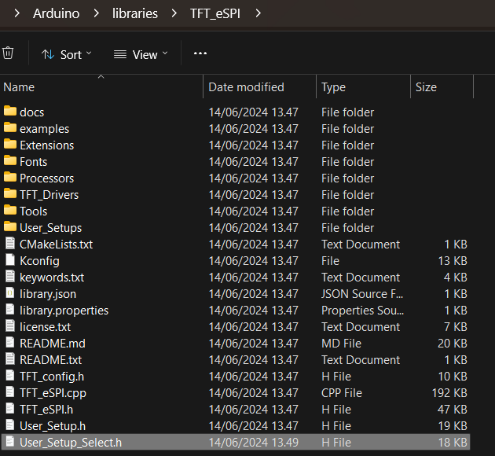
Arduino Setup
Åben filen Documents/Arduino/libraries/TFT_eSPI/User_Setup_Select.h
Skriv // foran alt tekst i linje 27 (User_Setup.h)
Fjern // foran linje 58.
Gem filen

Slide 14
ESP32 Setup - Driver

Slide 15
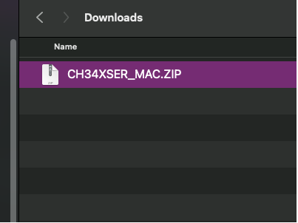
ESP32 Setup - Driver
Download MACOS Driver
https://www.wch-ic.com/downloads/CH34XSER_MAC_ZIP.html
GUIDE:
https://learn.adafruit.com/how-to-install-drivers-for-wch-usb-to-serial-chips-ch9102f-ch9102/mac-driver-installation

Slide 16
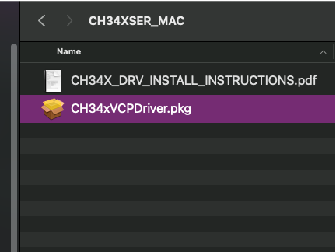
ESP32 Setup - Driver
After unzipping the folder, double click on the CH34xVCPDriver.pkg file.

Slide 17
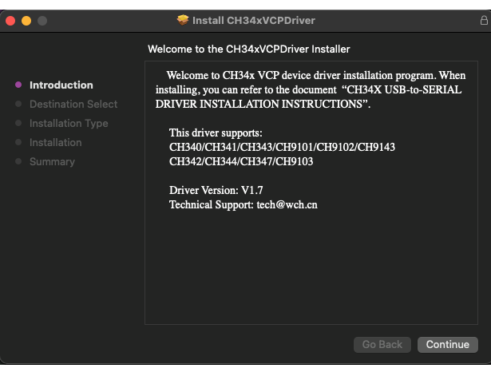
ESP32 Setup - Driver
This will launch the Installer dialog window. Click Continue.

Slide 18
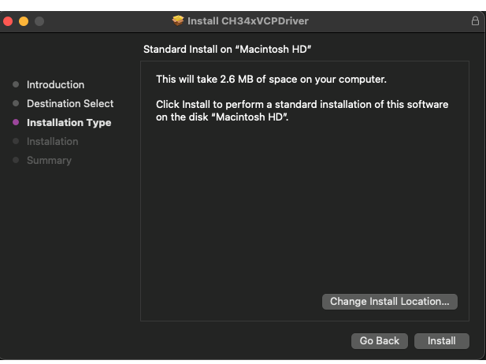
ESP32 Setup - Driver
Click Install to begin the installation.

Slide 19
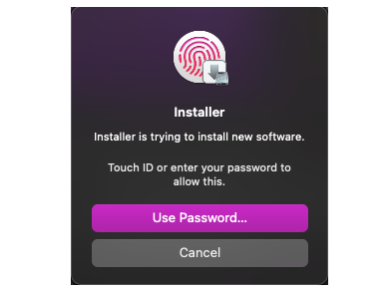
ESP32 Setup - Driver
A security notification may open after the installation begins. Use Touch ID or enter your password to allow the installation to continue.

Slide 20
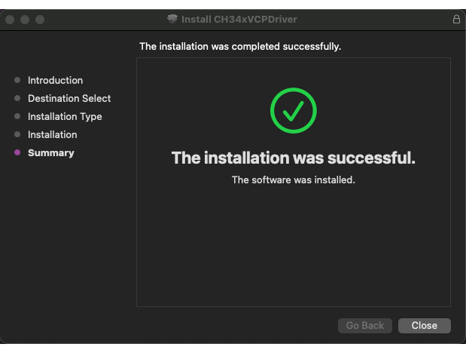
ESP32 Setup - Driver
You'll see a progress bar. Once the installation has completed you'll see a message in the dialog box that the installation was successful. Click Close to exit the box.

Slide 21
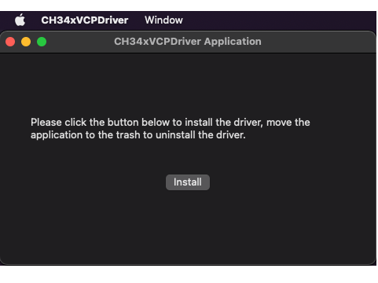
ESP32 Setup - Driver
This driver application may open automatically following the successful install above.
If it does not, open LaunchPad, find CH34xVCPDriver Application, and open the App.
Click Install to install the driver.

Slide 22
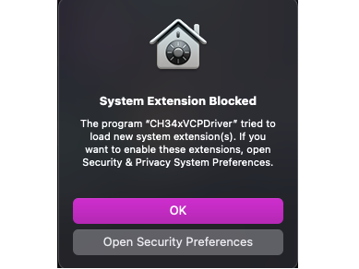
ESP32 Setup - Driver
A security warning may open. If so, click on Open Security Preferences.
You can find it in your settings fulder too

Slide 23
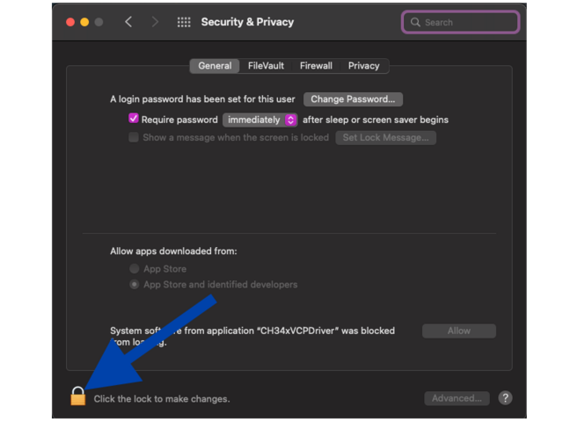
ESP32 Setup – Driver Fejlfinding
If you pressed OK, you MUST do the following:
In Security and Privacy, click on the lock icon in the lower-left corner to make changes

Slide 24
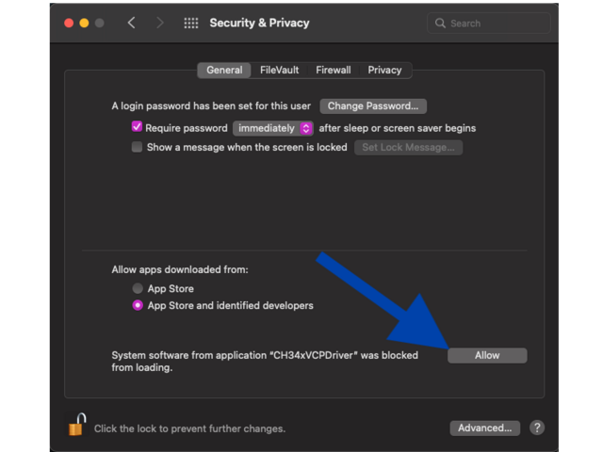
ESP32 Setup - Driver
Click Allow to allow the installation to continue.

Slide 25

ESP32 Setup - Driver
Once the installation finishes, you'll see a dialog box open that says "success". Click OK.

Slide 26
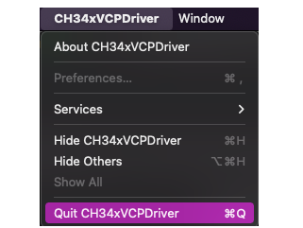
ESP32 Setup - Driver
Finally, quit the application. That's all there is to installing the WCH USB to serial driver for Mac OS X 11.0 and above!

Slide 27
ESP32 Setup – Forbind ESP32

Slide 28
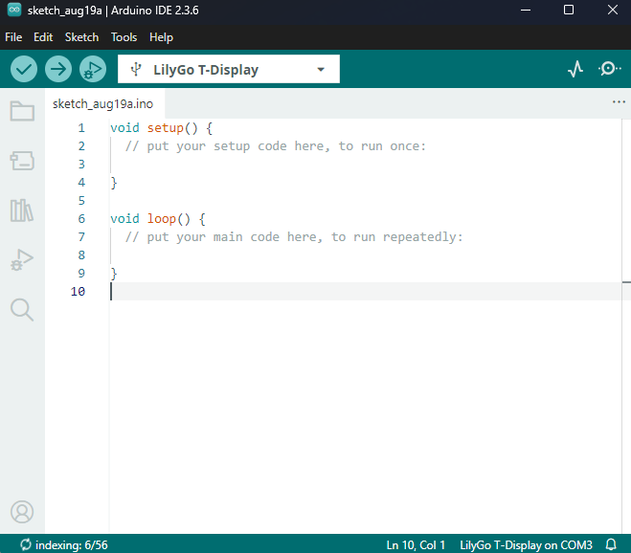
ESP32 Setup Forbind ESP32
I Arduino Ide skulle du gerne se ”LilyGo T-Display”, hvis du har fulgt Arduino setup. Ellers check følgende
Check at du har koblet din ESP32'er til din computer korrekt
Er det det rigtige kabel du bruger
Lader kabler til telefonen virker muligvis ikke (også selvom ESP32 blinker)
Check med en medstuderende om har en fungerende ESP32, om dit setup virker (med dit eget USB kabel osv)
Se i Security Settings, om du har givet USB driveren tilladelse

Slide 29
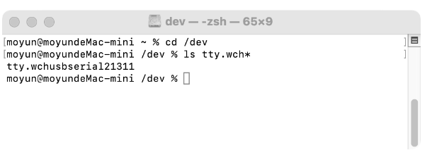
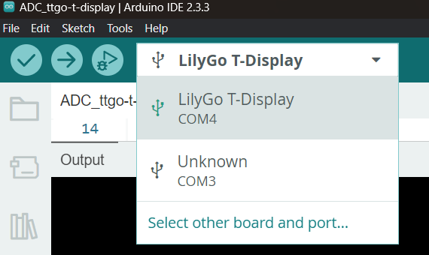
Arduino Setup - Mac
Check at du har koblet din ESP32'er til din computer korrekt
Er det det rigtige kabel du bruger
Lader kabler til telefonen virker muligvis ikke (også selvom ESP32 blinker)
Vælg den rigtige serial/COM port (på min mac var det tty.wchusbserial121311)
Hvis du ikke kan se din ESP32 i device manager, prøv at vend USB-C kablet rundt (det virker nogle gange)
Billedet er fra Windows, hvor den hedder "COM#"

Slide 30
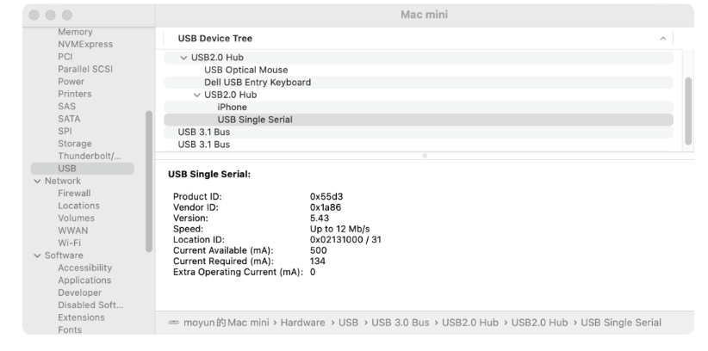
ESP32 Setup - MacOS check the COM port (Serial Port)
When plug the USB-to-SERIAL device into the USB port
[System Report] -> [Hardware] -> USB
[Terminal] -> ls /dev/tty*
You should see the “tty.wchusbserial#” where “#” is the assigned device number similar to Windows COM port assignment
In this case: tty.wchusbserial121311

Slide 31
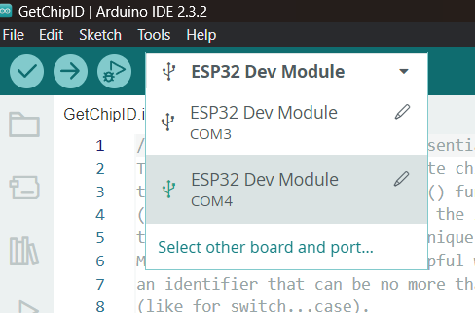
Arduino Setup - Mac
Check at du har koblet din ESP32'er til din computer korrekt
Er det det rigtige kabel du bruger
Lader kabler til telefonen virker muligvis ikke (også selvom ESP32 blinker)
Vælg den rigtige serial/COM port (på min mac var det tty.wchusbserial121311)
Hvis du ikke kan se din ESP32 i device manager, bruger du muligvis et oplader USB ledning.
Billedet er fra Windows, hvor den hedder "COM#"
Brug følgende board: ESP32 Dev Module

